Slide 1


Slide 2





Azure AD B2B Conditional Access Advanced Scenarios

Slide 3


Ronni Pedersen
Freelance Cloud Architect
Microsoft MVP: Enterprise Mobility (10 years)
Founder: System Center User Group Denmark
Microsoft Certified Trainer
Contact Me
Twitter: @ronnipedersen
Blog: https://www.ronnipedersen.com/
Mail: mail@ronnipedersen.com
Phone: +45 2085 9452
About me...

Slide 4



Jan Ketil Skanke
Principal Cloud Architect
Microsoft MVP: Enterprise Mobility CO-Founder: MVPDagen.no
Microsoft Certified Trainer
Contact Me
Twitter: @JankeSkanke
Blog: https://jankesblog.com/
Phone: +47 952 99 440
About me...

Slide 5

Key Takeways
Introduction to Azure B2B
Enable Guest Access and Guest Invite
Azure B2B and Conditional Access
Azure MFA and Terms of Use
Azure B2B Access Control
Review and Revoke Access
Securing Data
Azure Information Protection
Q and A
5

Slide 6
Introduction to Azure B2B
Notes:
Terms of Use – Guest user logon
MFA Enrollment requirements for Guests
A few advanced features ☺

Slide 7








How much control do you have over access?
Resources in Azure
Microsoft Azure Active Directory
On-premises applications
On- premises
@RonniPedersen

Slide 8
Governance, Risk Management & Compliance The top 4 questions we hear from customers…
Who has/should have access to what resources?
01
What are they doing with that access?
02
Are there effective organizational controls for managing access?
03
Can auditors verify that the controls are working?
04
@RonniPedersen
Notes:
Top concerns that I hear from customers.

Slide 9
What is Azure AD B2B collaboration?
Work safely and securely with users from any other organization
Organizations can be with Azure AD
Cloud only and hybrid
Or without Azure AD
On-prem AD only
Even without an IT organization (bring your own identity)
Hotmail, Gmail, Yahoo etc.
@RonniPedersen

Slide 10

DEMO
Invite/Create Guest Users

Slide 11
Guest Access for SharePoint Online
Turn sharing on or off for SharePoint Online
Global settings that affect all of SharePoint Online
Site collection level
Global Settings
Anonymous access is enabled by default
Limit external sharing using security groups
Limit external sharing using domains
@RonniPedersen

Slide 12
Microsoft Teams
Guest sharing is disabled by default
By default you share the entire Team Site
Share a single document with external user can be enabled
https://msunified.net/2018/01/11/share-a-single-document-with-external-user-in-microsoft-teams/
@RonniPedersen

Slide 13

DEMO
Enable/Disable Guest Access

Slide 14
Conditional Access and B2B
Notes:
Terms of Use – Guest user logon
MFA Enrollment requirements for Guests
A few advanced features ☺

Slide 15
“THE PERIMETER CAN’T PROTECT THE DATA ANYMORE»
@JankeSkanke

Slide 16
Conditional Access
Example: When your contractors are trying to access our confidential data from networks that are not trusted, then block access.
When this happens
Then do this
@JankeSkanke

Slide 17
When this happens
Then do this
Condition Statement
Controls
@JankeSkanke
Conditional Access Policy

Slide 18
Conditional Access
When this happens
Then do this
Conditional Access Policy
Condition Statement
Controls
@JankeSkanke

Slide 19
AAD Premium Features on Guests?
YES WE CAN !!
Conditional Access to apps
Multifactor Authentication
Terms of Use
Location / Risk
@JankeSkanke

Slide 20
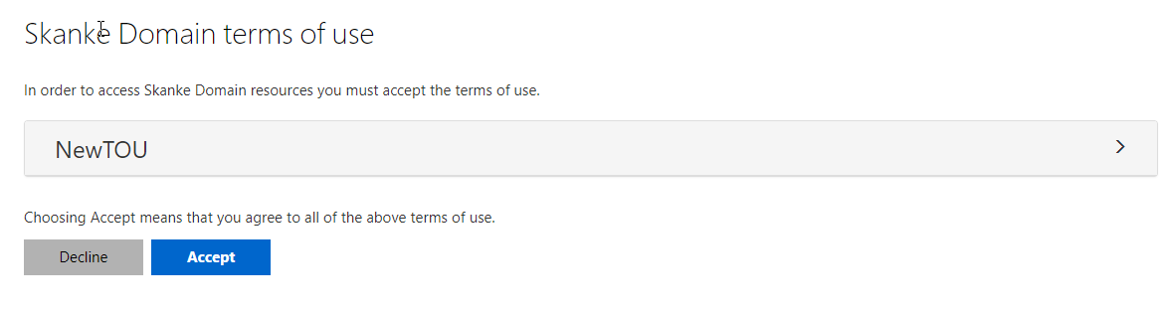
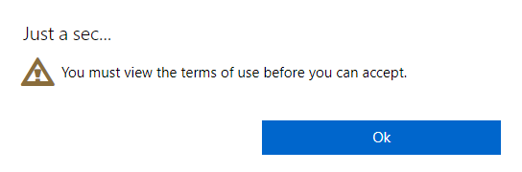
Terms of Use
Guests need to comply with YOUR written policy before accessing data
Can be enforced on first logon or later if changed
@JankeSkanke

Slide 21
Azure MFA for Guest
Guests registers for MFA on first logon
Trigger MFA on all or selected Apps for Guest
May cause «Double-MFA»
Same options as your normal users
@JankeSkanke

Slide 22

DEMO
@JankeSkanke
Notes:
DEMO:
Get-AzureADDirectoryRoleMember
https://docs.microsoft.com/en-us/powershell/module/azuread/get-azureaddirectoryrolemember?view=azureadps-2.0

Slide 23
Azure B2B Access Control
Notes:
Terms of Use – Guest user logon
MFA Enrollment requirements for Guests
A few advanced features ☺

Slide 24
Azure AD Access Control
External User Rights
Who can Invite, how to control it
Guest Inviter Role
Self-Service Access
Pre-aproved domains
@RonniPedersen

Slide 25
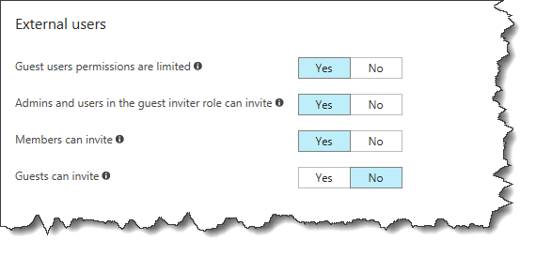
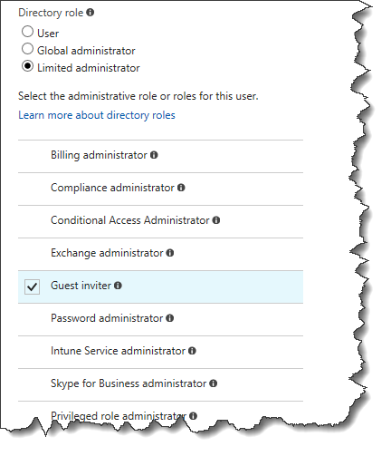
Access Control - External User Rights
Who can Invite, and how to control it?
Default: All Members can invite!
Control with Guest Inviter Role
Limited Administrator / Guest Inviter
@RonniPedersen

Slide 26

DEMO
Azure B2B Access Control
Notes:
DEMO:
Get-AzureADDirectoryRoleMember
https://docs.microsoft.com/en-us/powershell/module/azuread/get-azureaddirectoryrolemember?view=azureadps-2.0

Slide 27
Ensuring appropriate access to resources
How do you determine who should still have access?
What about guests or contractors that were given ad-hoc access?
How should the decision-makers be involved in the process?
What aspects of the processes should be automated?
Access Review: Azure AD Premium P2
@RonniPedersen

Slide 28
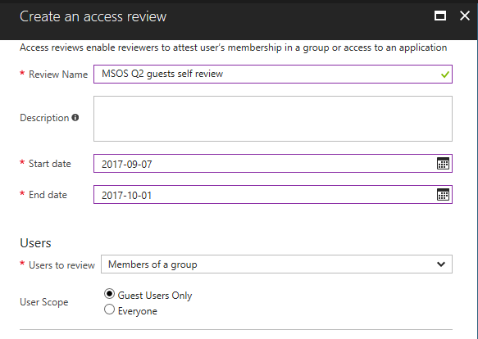
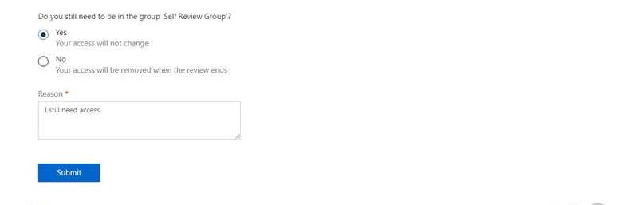
Access reviews (preview)
Recertify: attest and audit continued access
​Review Office group members, security group members, and users assigned to applications
Optionally, scope the reviews to just guests
Select reviewers from the resource
Group owners
Members review their own access
Select other specific individuals
Create an access review
Reviewers give feedback
Results applied
Review audit reports
Notes:
Manage guest access with Azure AD access reviews
https://docs.microsoft.com/en-us/azure/active-directory/active-directory-azure-ad-controls-manage-guest-access-with-access-reviews
Complete an access review of members of a group or users' access to an application in Azure AD
https://docs.microsoft.com/en-us/azure/active-directory/active-directory-azure-ad-controls-complete-access-review

Slide 29
Azure AD Access Review
Groups
Perform an access review for guests (Manuel)
Guests can review their own membership
Ask the owner to review guest's membership in a group
Applications
Let Guests review their own access to an Application
Ask Owner to review a guest's access to an application
@RonniPedersen

Slide 30

DEMO
Azure B2B Access Review

Slide 31
How you can use Azure AD access reviews
Users asked to justify their need for application access
Office group owners review their groups’ memberships
Use alongside Office group expiration (also in preview)
Clean up unneeded guest access to applications
Ensure on-premises groups have only authorized members
@RonniPedersen

Slide 32
Managing privileged access
What about access for IT personnel who manage applications?
What happens when guests or contractors need to manage?
How do you make sure they only have access when needed?
What are the best practices for Azure?
@RonniPedersen

Slide 33
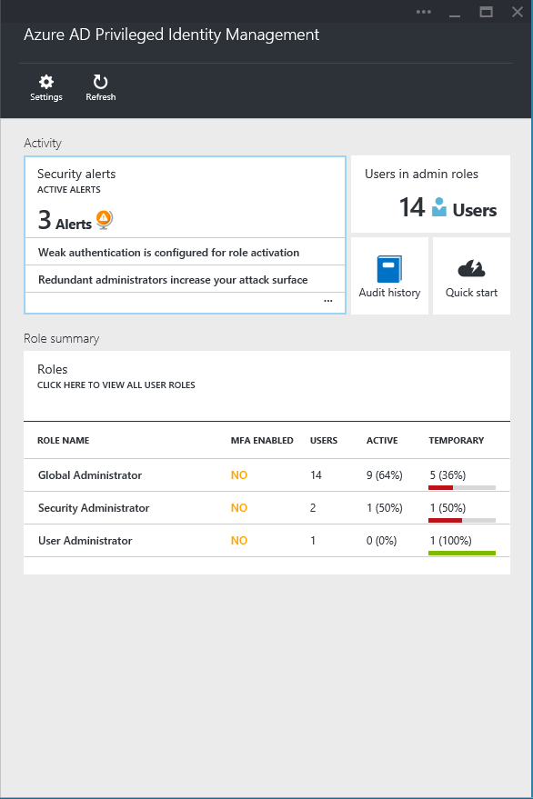
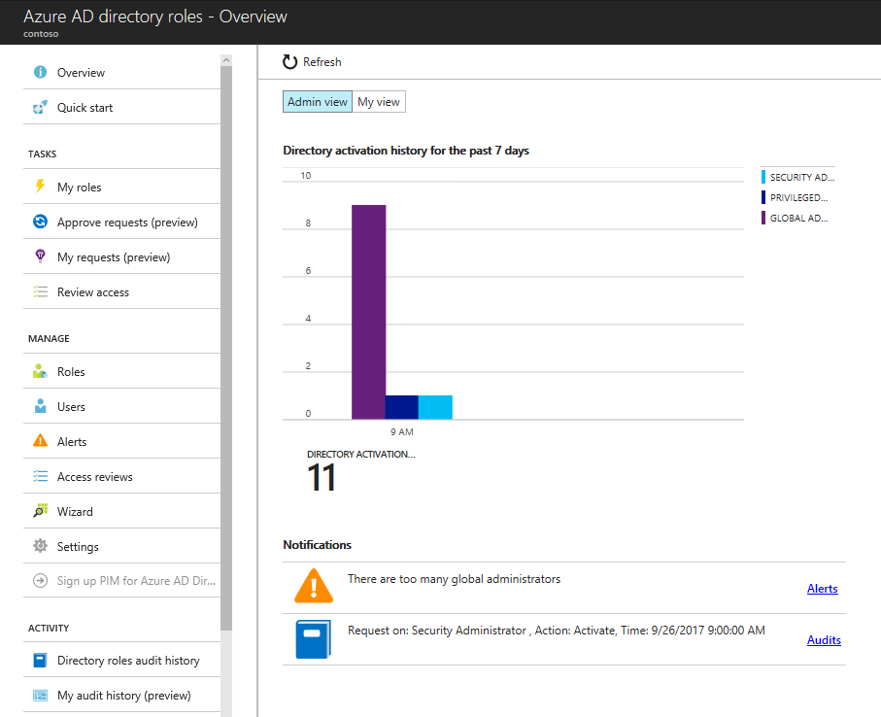
Privileged Identity Management
Discover, restrict, and monitor privileged identities
Enforce on-demand, just-in-time access
Optionally leverage per-role approval workflows
Attest admin role membership with access reviews
Visibility through alerts and audit reports
Ordinary user
Global administrator
Role privileges expire after a specified interval
Ordinary user

Slide 34

DEMO
Azure B2B Privileged Identity Management

Slide 35
Azure Information Protection
Notes:
Terms of Use – Guest user logon
MFA Enrollment requirements for Guests
A few advanced features ☺

Slide 36
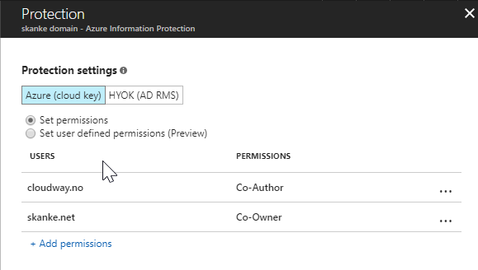
Azure Information Protection (B2B)
Create B2B labels with protection
Add entire domains (@demodummies.com)
@JankeSkanke

Slide 37
Azure Information Protection (B2B)
Create B2B labels with protection
Add entire domains (@demodummies.com)
@JankeSkanke

Slide 38

DEMO
@JankeSkanke
Notes:
DEMO:
Get-AzureADDirectoryRoleMember
https://docs.microsoft.com/en-us/powershell/module/azuread/get-azureaddirectoryrolemember?view=azureadps-2.0

Slide 39
Licenses
5:1
@JankeSkanke

Slide 40
Licenses
Azure AD Free capabilities are available for guest users without additional licensing.
If you want to provide access to paid Azure AD features to B2B users, you must have enough licenses to support those B2B guest users.
An inviting tenant with an Azure AD paid license has B2B collaboration use rights to an additional five B2B guest users invited to the tenant.
@JankeSkanke
Notes:
There is no need to actually assign licenses to B2B user accounts. Based on the 5:1 ratio, licensing is automatically calculated and reported.
If no paid Azure AD license exists in the tenant, every invited user gets the rights that the Azure AD Free edition offers.
If a B2B collaboration user already has a paid Azure AD license from their organization, they do not consume one of the B2B collaboration licenses of the inviting tenant.
https://docs.microsoft.com/en-us/azure/active-directory/active-directory-azure-ad-controls-manage-user-access-with-access-reviews

Slide 41

Thank You!!

